Slide 1
West Yorkshire Devolution
Mayoral Policing and Crime Functions

Slide 2
Contents
1. Introductions
2. Current position, funding and budgets
3. Transferring policing and crime functions
4. Organisational structure
5. Questions
Notes:
Ben

Slide 3
Introductions
West Yorkshire Combined Authority
Ben Still, Managing Director
Alan Reiss, Director of Policy, Strategy and Communications
Emily Burton, Executive Assistant
Leeds City Council
Susie Benton, Head of Electoral Services
Office of the Police and Crime Commissioner
Janine Nelson, Chief of Staff
West Yorkshire Police
John Robins QPM, Chief Constable
Russ Foster, Deputy Chief Constable
Katherine Johnson, Assistant Chief Officer
Notes:
Ben

Slide 4
Police and crime functions
The Devolution Order provides for the transfer of police and crime functions to take place in May 2021 at the same time as the Mayoral Election. This enables a single election to take place for a Mayor who will also take on Police and Crime Commissioner (PCC) functions from the start of their term.
These powers are Mayoral functions, i.e. exercisable by the Mayor.
Outside of London, only Greater Manchester Combined Authority’s Mayor has PCC functions.
Notes:
Ben

Slide 5
Police and crime functions
A comprehensive change programme is underway with the Office of the Police and Crime Commissioner, (OPCC), West Yorkshire Police (WYP), the Association of Police and Crime Commissioners (APCC), and the Home Office.
This transfer includes:
The Office of the PCC, which includes circa 30 staff who support the PCC in discharging their functions
Land, assets and property
ICT and data
A review of the existing governance and audit arrangements for the OPCC and West Yorkshire Police
Contracts and assets relating to the National Police Air Service
Notes:
Ben

Slide 6
Policing and Crime functions and funding

Slide 7
What does the PCC do?
Sets objectives and budgets
Sets the high level priorities for the Police Service
Sets standards and objectives for delivery through the Police and Crime Plan
Sets the police budget and the policing precept
Commissions services to support victims, prevent crime and promote community safety
Maintains accountability
Hold the Chief Constable to account for the exercise of their functions, the performance of the Police Service, and the delivery of the Police and Crime Plan
Appoints the Chief Constable, and be responsible for complaints and conduct
Represents the public by engaging with communities across West Yorkshire and using their views to inform the Police and Crime Plan
Works in partnership with agencies, partners, and communities to represent their interests, improve public safety, and ensure the police and partners are delivering the best possible service to keep communities safe.
Notes:
Janine

Slide 8
Current areas of the PCC’s work
The PCC attends the following:
Serious Violence Portfolio Group (APCC lead)
National Anti Trafficking Modern Slavery Network (APCC lead)
Automatic Number Plate Recognition (APCC lead)
Criminal Justice and Victims Group (APCC Member not lead)
Biometrics and Data Ethics Working Group (APCC Member not Lead)
National ANPR Service Programme Board (APCC Member not lead)
National PCC sport and Youth Crime Prevention Board (APCC Member not lead)
YatH Rehabilitation Partnership (Chair)
West Yorkshire Local Criminal Justice Board (Chair)
Partnership Executive Group (Chair)
Tri Service Executive Board (Joint Chair)
North East Business Resilience Centre (Board Member)
NPCC Audit and Assurance Board (Board Member)
Modern Slavery Organised Immigration Crime Programme (Board Member)
Notes:
Janine

Slide 9
Working with West Yorkshire Police
The PCC is responsible for the totality of policing, and work closely with West Yorkshire Police’s 9,886 officers and staff to ensure that all force activity delivers outcomes in line with strategic objectives and priorities.
A number of formal and informal forums currently oversee this:
Community Outcomes Meeting
Delivery Quarterly
Joint Executive Group
Bilateral meeting – Chief Constable and PCC
Joint Independent Audit & Ethics Committee
Good Governance Group
Notes:
Janine

Slide 10
Police and Crime Plan
The Police and Crime Plan:
Sets the strategic direction and service standards for the OPCC and West Yorkshire Police
Demonstrates how the Police are held to account for their delivery
Directs responsible use of resources
Reflects the services the PCC will deliver (in-house, by grants or commissioning) that will
Reduce crime and disorder
Help victims of crime or anti-social behaviour
Improve community safety
When adopting or changing plans, the PCC must:
Consult the public
Consult the Chief Constable
Obtain the view of the Police & Crime Panel
Notes:
Janine

Slide 11
Partnership working and commissioning
The PCC commissions a number of different providers to help with the delivery of services aligned with the objectives of the Police and Crime Plan, to reduce crime and help victims to cope and recover from the harm they have suffered.
Central to the success of effective commissioning is the understanding and analysis of need and demand from the people who are involved in both use and provision of the service. This requires collaboration with
District, West Yorkshire, Regional and National level authorities
Communities and relevant groups
The local third sector
In 2020 / 2021 9 contracts were awarded ranging between £8,000 and £2.3 million
152 grants were made between £2,000 and £1.2 million
The total value in 2020 / 2021 and 2021 / 2022 is £12 million
Notes:
Janine

Slide 12
Police and Crime Panel
The PCC attends the Police and Crime Panel:
12 elected members from the five West Yorkshire authorities
2 independent members
The Panel is responsible for:
Reviewing and making recommendations on the PCC’s five-year Police and Crime Plan
Reviewing the PCC’s Annual Report which will outline their performance against the Police and Crime Plan.
Investigating non-criminal complaints made against the PCC.
Reviewing the amount of Council Tax the PCC intends to collect from each household to support policing. The Panel can veto this proposal.
Reviewing, challenging or endorsing the PCC’s proposal on the appointment of a Chief Constable.
Confirming the appointment of senior staff who will be working for the PCC.
Notes:
Janine

Slide 13
National and Regional functions
The West Yorkshire PCC is currently responsible for:
National Police Air Service (NPAS)
Video Identification Parades Electronic Recording (VIPER)
Police National Legal Database (PNLD)
National Child Abusive Images Database (CAID)
Counter Terrorism Policing North East (CTPNE)
Regional Organised Crime Unit Yorkshire and Humber (ROCU)
Responsibility for NPAS governance will transfer to the MCA in May, and will continue to provide borderless air support to the police forces across England and Wales from a national network of bases.
Operational budget
14 EC135 and EC145 helicopters
4 fixed wing aeroplanes
14 national bases
Notes:
John / Russ

Slide 14
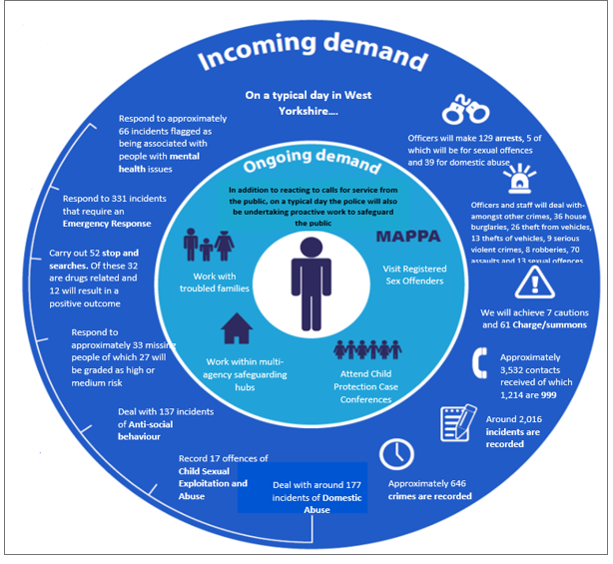
West Yorkshire Police Demand
Notes:
John / Russ

Slide 15
Budgets
2021 / 2022 Budgets
£500m group net revenue budget. Within this total, the areas that are directly managed by the OPCC are:
£1.7m PCC office costs
£5.2m Community Safety Fund
Around 75% of the budget is spent on staffing costs.
The budget is set on an annual basis by the PCC based on proposals from West Yorkshire Police.
The PCC and Section 151 officer have a responsibility to make sure that a balanced budget is set.
In addition to the annual budget a medium-term forecast is also produced by West Yorkshire Police and allows for medium term financial planning.
Notes:
Katherine

Slide 16
Funding Sources
Annual net revenue funding comes from two main sources
Central Government Funding
Police Council Tax (roughly eleven percent of the Council Tax that West Yorkshire pays funds policing). The Police Council Tax funding represents 28% of the revenue funding for West Yorkshire Police Group.
Specific Grants in addition to the above funding are received and ring-fenced for specific purposes through a direct grant from Central Government for example:
Violence Reduction Unit
Victims and Witnesses Fund Grant
Capital funding is through four main sources:
Capital receipts
Capital grant
Direct Revenue Funding
Borrowing
Notes:
Katherine

Slide 17
Transferring police and crime powers

Slide 18
Deputy Mayor for Policing and Crime
West Yorkshire Mayor
(Elected)
Deputy Mayor
(elected member of the Combined
Authority appointed by Mayor )
Deputy Mayor for Policing and Crime
(Appointed)
Notes:
Ben

Slide 19
Mayoral functions and delegation
Key PCC functions will be:
secure the maintenance of an efficient and effective police force and hold the Chief Constable to account
issue a Police and Crime Plan
Only the Mayor can:
issue a Police and Crime Plan
calculate a council tax or budget requirement
appoint, suspend, or call on a Chief Constable to retire or resign
Some PCC Functions can only be exercised by the Mayor or delegated to the Deputy Mayor of Policing and Crime:
determine police and crime objectives
attend a meeting of the Police and Crime Panel
prepare an annual report
Notes:
Alan

Slide 20
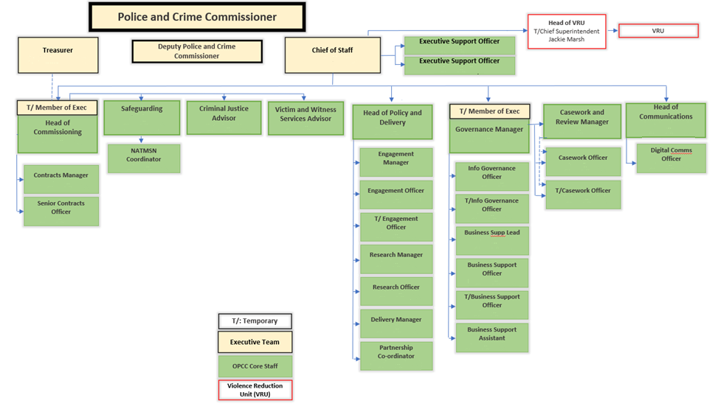
Scope of Transfer
Notes:
TBC?

Slide 21
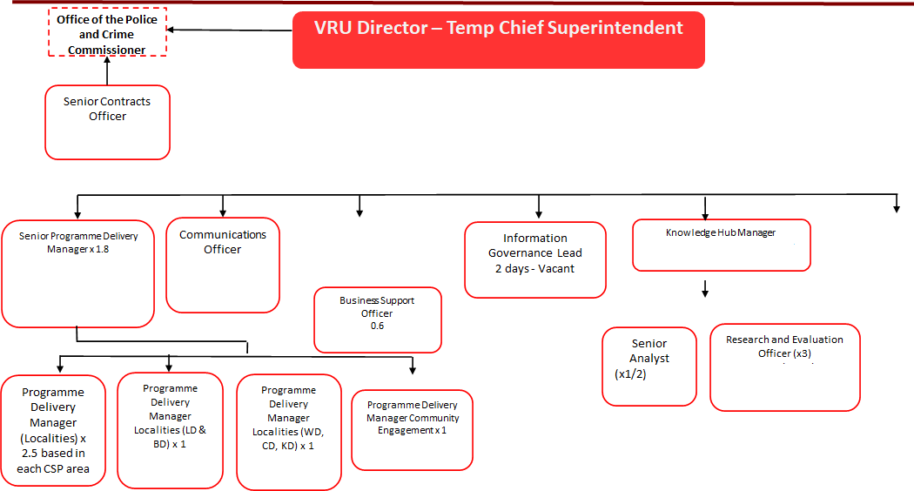
Scope of Transfer
Notes:
TBC?

Slide 22
Organisational structure

Slide 23
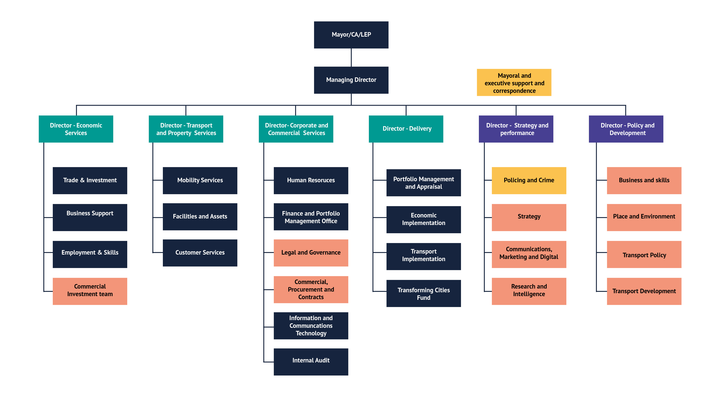
A new way of working
Notes:
Ben

Slide 24
Questions?
mayoral.election@westyorks-ca.gov.uk

